Slide 1

SESSIONS

Slide 2
Starting a Session
Starting a session requires calling the PHP function session_start before any HTML has been output, similarly to how cookies are sent during header exchanges.
Then, to begin saving session variables, you just assign them as part of the $_SESSION array, like this:
$_SESSION['variable'] = $value;
They can then be read back just as easily in later program runs, like this:
$variable = $_SESSION['variable'];

Slide 3
Starting a Session
For example, assume that you have an application that always needs access to the username, password, first name, and last name of each user, as stored in the table users
So, let’s further modify authenticate.php from the previous lecture to set up a session once a user has been authenticated…

Slide 4
<?php //authenticate2.php
require_once 'login.php’;
$connection = new mysqli($hn, $un, $pw, $db);
if ($connection->connect_error) die($connection->connect_error);
if (isset($_SERVER['PHP_AUTH_USER']) && isset($_SERVER['PHP_AUTH_PW’])) {
$un_temp = mysql_entities_fix_string($connection, $_SERVER['PHP_AUTH_USER']);
$pw_temp = mysql_entities_fix_string($connection, $_SERVER['PHP_AUTH_PW’]);
$query = "SELECT * FROM users WHERE username='$un_temp’”;
$result = $connection->query($query);
if (!$result) die($connection->error);
elseif ($result->num_rows) {
$row = $result->fetch_array(MYSQLI_NUM);
$result->close();
$salt1 = "qm&h*"; $salt2 = "pg!@";
$token = hash('ripemd128', "$salt1$pw_temp$salt2");
…
Notes:
Setting a session after successful authentication

Slide 5
…
if ($token == $row[3]) {
session_start();
$_SESSION['username'] = $un_temp;
$_SESSION['password'] = $pw_temp;
$_SESSION['forename'] = $row[0];
$_SESSION['surname'] = $row[1];
echo "$row[0] $row[1] : Hi $row[0], you are now logged in as '$row[2]’”;
die ("<p><a href=continue.php>Click here to continue</a></p>");
}
else die("Invalid username/password combination");
}
else die("Invalid username/password combination");
}
else {
header('WWW-Authenticate: Basic realm="Restricted Section“’);
header('HTTP/1.0 401 Unauthorized’);
die ("Please enter your username and password");
}
…
Notes:
Setting a session after successful authentication

Slide 6
…
$connection->close();
function mysql_entities_fix_string($connection, $string)
{
return htmlentities(mysql_fix_string($connection, $string));
}
function mysql_fix_string($connection, $string)
{
if (get_magic_quotes_gpc()) $string = stripslashes($string);
return $connection->real_escape_string($string);
}
?>
Notes:
Setting a session after successful authentication

Slide 7
Starting a Session
One other addition to the program is the “Click here to continue” link with a destination URL of continue.php
This will be used to illustrate how the session will transfer to another program or PHP web page…

Slide 8
<?php // continue.php
session_start();
if (isset($_SESSION['username']))
{
$username = $_SESSION['username’];
$password = $_SESSION['password’];
$forename = $_SESSION['forename’];
$surname = $_SESSION['surname’];
echo "Welcome back $forename.<br>
Your full name is $forename $surname.<br>
Your username is '$username’ and your password is '$password'.";
}
else echo "Please <a href='authenticate2.php'>click here</a> to log in.";
?>
Notes:
Retrieving session variables

Slide 9
Starting a Session
Now you are ready to call up authenticate2.php into your browser.
Test it:
Enter a username of bsmith and password of mysecret (or pjones and acrobat) when prompted, and click the link to load in continue.php

Slide 10
Starting a Session
You need only to call up session_start and look up any variables to which you need access from $_SESSION.
A quick test of whether $_SESSION['username'] has a value is enough to let you know that the current user is authenticated, because session variables are stored on the server (unlike cookies, which are stored on the web browser) and can therefore be trusted.
If $_SESSION['username'] has not been assigned a value, no session is active, so the last line of code directs users to the login page at authenticate2.php

Slide 11
Starting a Session
NOTE (just in case…):
The continue.php program prints back the value of the user’s password to show you how session variables work.
In practice, you already know that the user is logged in, so you shouldn’t need to keep track of (or display) any passwords, and in fact doing so would be a security risk.

Slide 12
Ending a Session
When the time comes to end a session, usually when a user requests to log out from your site, you can use the session_destroy function in association.
<?php // A handy function to destroy a session and its data
function destroy_session_and_data()
{
session_start();
$_SESSION = array(); // Delete all the information in the array
setcookie(session_name(), '', time() - 2592000, '/’);
session_destroy();
}
?>

Slide 13
<?php //better continue.php
session_start();
if (isset($_SESSION['username’])) {
$username = $_SESSION['username’];
$password = $_SESSION['password’];
$forename = $_SESSION['forename’];
$surname = $_SESSION['surname’];
destroy_session_and_data();
echo "Welcome back $forename.<br> Your full name is $forename $surname.<br> Your username is '$username’ and your password is '$password'.";
}
else echo "Please <a href='authenticate2.php'>click here</a> to log in.";
function destroy_session_and_data() {
$_SESSION = array();
setcookie(session_name(), '', time() - 2592000, '/’);
session_destroy();
}
?>
The first time you navigate from authenticate2.php to continue.php, it will display all the session variables.

Slide 14
<?php //better continue.php
session_start();
if (isset($_SESSION['username’])) {
$username = $_SESSION['username’];
$password = $_SESSION['password’];
$forename = $_SESSION['forename’];
$surname = $_SESSION['surname’];
destroy_session_and_data();
echo "Welcome back $forename.<br> Your full name is $forename $surname.<br> Your username is '$username’ and your password is '$password'.";
}
else echo "Please <a href='authenticate2.php'>click here</a> to log in.";
function destroy_session_and_data() {
$_SESSION = array();
setcookie(session_name(), '', time() - 2592000, '/’);
session_destroy();
}
?>
But, because of the call to destroy_session_and_data, if you then click your browser’s Reload button, the session will have been destroyed and you’ll be prompted to return to the login page.

Slide 15
Setting a Time-Out
There are other times when you might wish to close a user’s session yourself, such as when the user has forgotten or neglected to log out, and you want the program to do so for his own security.
To do this, use the ini_set function as follows. This example sets the time-out to exactly one day:
ini_set('session.gc_maxlifetime', 60 * 60 * 24);
If you wish to know what the current time-out period is, you can display it using the following:
echo ini_get('session.gc_maxlifetime');
Notes:
You do this by setting the time-out after which a logout will automatically occur if there has been no activity

Slide 16



session variables are stored on the server
session_start();
if (isset($_SESSION[‘variable’]))
…
$username = $_SESSION[‘variable’];
session_start
before HTML
Creating
Recovering
$_SESSION['variable'] = $value;
destroy_session_and_data();
$_SESSION = array();
Delete cookie
session_destroy();
SESSIONS
Destroying
Auto Destroying
session_destroy();
echo ini_get('session.gc_maxlifetime');
ini_set('session.gc_maxlifetime', 60 * 60 * 24);
// One day

Slide 17

SESSION SECURITY

Slide 18
Session Security
Although I mentioned that once you had authenticated a user and set up a session, you could safely assume that the session variables were trustworthy, this isn’t exactly the case…
The reason is that it’s possible to use packet sniffing (sampling of data) to discover session IDs passing across a network.
Additionally, if the session ID is passed in the Get part of a URL, it might appear in external site server logs.
The only truly secure way of preventing these from being discovered is to implement Secure Sockets Layer (SSL) and run HTTPS instead of HTTP web pages.
Check https://httpd.apache.org/docs/2.4/ssl/ssl_howto.html for details on setting up a secure web server.

Slide 19
Session Security - Preventing session hijacking
When SSL is not a possibility, you can further authenticate users by storing their IP address along with their other details by adding a line such as the following when you store their session:
$_SESSION['ip'] = $_SERVER['REMOTE_ADDR’];
Then, as an extra check, whenever any page loads and a session is available, perform the following check.
It calls the function different_user if the stored IP address doesn’t match the current one:
if ($_SESSION['ip'] != $_SERVER['REMOTE_ADDR']) different_user();

Slide 20
Session Security - Preventing session hijacking
What code you place in your different_user function is up to you.
I recommend that you simply delete the current session and ask the user to log in again due to a technical error.
Don’t say any more than that, or you’re giving away potentially useful information.
Of course, you need to be aware that users on the same proxy server, or sharing the same IP address on a home or business network, will have the same IP address…

Slide 21
Session Security - Preventing session hijacking
You can also store a copy of the browser user agent string, a string that developers put in their browsers to identify them by type and version
Which might also distinguish users due to the wide variety of browser types, versions, and computer platforms. Use the following to store the user agent:
$_SESSION['ua'] = $_SERVER['HTTP_USER_AGENT’];
And use this to compare the current agent string with the saved one:
if ($_SESSION['ua'] != $_SERVER['HTTP_USER_AGENT']) different_user();
Notes:
Again, if this is a problem for you, use SSL.

Slide 22
Session Security - Preventing session hijacking
Or, better, combine the two checks like this and save the combination as a hash string:
$_SESSION['check'] = hash('ripemd128', $_SERVER['REMOTE_ADDR'] .
$_SERVER['HTTP_USER_AGENT’]);
And use this to compare the current and stored strings:
if ($_SESSION['check'] != hash('ripemd128', $_SERVER['REMOTE_ADDR'] .
$_SERVER['HTTP_USER_AGENT'])) different_user();
Notes:
Try your “signature” here: https://panopticlick.eff.org/

Slide 23
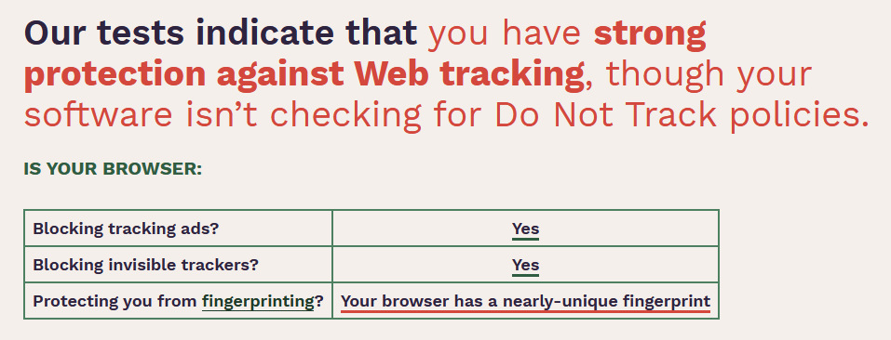
https://panopticlick.eff.org/
Firefox with uBlock Origin

Slide 24
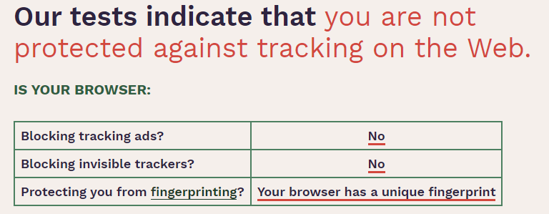
https://panopticlick.eff.org/
Edge

Slide 25
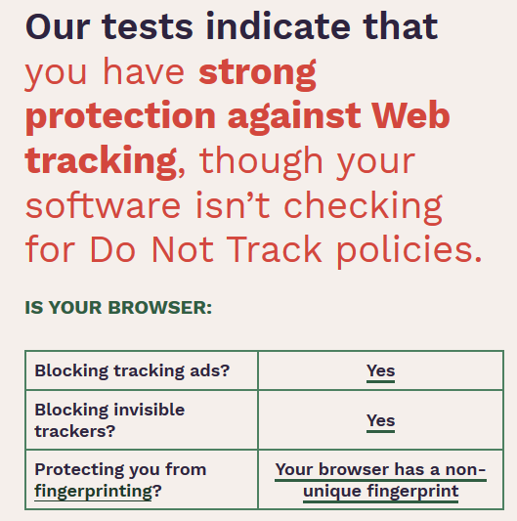
https://panopticlick.eff.org/
TOR

Slide 26
Session Security - Preventing session fixation
Session fixation happens when a malicious user tries to present a session ID to the server rather than letting the server create one.
It can happen when a user takes advantage of the ability to pass a session ID in the Get part of a URL, like this:
http://yourserver.com/authenticate.php?PHPSESSID=123456789
In this example, the made-up session ID of 123456789 is being passed to the server.

Slide 27
Session Security - Preventing session fixation
Now, consider this code, which is susceptible to session fixation
<?php // sessiontest.php, a session susceptible to session fixation
session_start();
if (!isset($_SESSION['count'])) $_SESSION['count'] = 0;
else ++$_SESSION['count’];
echo $_SESSION['count'];
?>

Slide 28
Session Security - Preventing session fixation
Once it’s saved, call it up in your browser using the following URL (prefacing it with the correct pathname, such as http://localhost/):
sessiontest.php?PHPSESSID=1234
Press Reload a few times, and you’ll see the counter increase.
Now try browsing to:
sessiontest.php?PHPSESSID=5678
Press Reload a few times here, and you should see it count up again from 0.
Leave the counter on a different number than the first URL and then go back to the first URL and see how the number changes back.
You have created two different sessions of your own choosing here, and you could easily create as many as you needed.

Slide 29
Session Security - Preventing session fixation
The reason this approach is so dangerous is that:
A malicious attacker could try to distribute these types of URLs to unsuspecting user
If any of them followed these links, the attacker would be able to come back and take over any sessions that had not been deleted or expired!

Slide 30
Session Security - Preventing session fixation
To prevent this, add a simple check to change the session ID using session_regenerate_id
This function keeps all current session variable values, but replaces the session ID with a new one that an attacker cannot know.

Slide 31
Session Security - Preventing session fixation
To do this, check for a special session variable that you arbitrarily invent
<?php // Session Regeneration
session_start();
if (!isset($_SESSION['initiated’]))
{
session_regenerate_id();
$_SESSION['initiated'] = 1;
}
if (!isset($_SESSION['count'])) $_SESSION['count'] = 0;
else ++$_SESSION['count’];
echo $_SESSION['count'];
?>
If it doesn’t exist, you know that this is a new session, so you simply change the session ID and set the special session variable to note the change

Slide 32
Session Security - Preventing session fixation
This way, an attacker can come back to your site using any of the session IDs that he or she generated, but none of them will call up another user’s session, as they will all have been replaced with regenerated IDs.
If you want to be ultra-paranoid, you can even regenerate the session ID on each request!

Slide 33
Session Security - Forcing cookie-only sessions
If you are prepared to require your users to enable cookies on your website, you can use the ini_set function, like this:
ini_set('session.use_only_cookies', 1);
With that setting, the ?PHPSESSID= trick will be completely ignored.
If you use this security measure, I also recommend that you inform your users that your site requires cookies, so they know what’s wrong if they don’t get the results they want..

Slide 34
Session Security - Using a shared server
On a server shared with other accounts, you will not want to have all your session data saved into the same directory as theirs.
Instead, you should choose a directory to which only your account has access (and that is not web-visible) to store your sessions, by placing an ini_set call near the start of a program, like this:
ini_set('session.save_path', '/home/user/myaccount/sessions’);
The configuration option will keep this new value only during the program’s execution, and the original configuration will be restored at the program’s ending.
This sessions folder can fill up quickly; you may wish to periodically clear out older sessions according to how busy your server gets. The more it’s used, the less time you will want to keep a session stored.

Slide 35
Session Security
Remember that your websites can and will be subject to hacking attempts.
There are automated bots running riot around the Internet, trying to find sites vulnerable to exploits!
So whatever you do, whenever you are handling data that is not 100 percent generated within your own program, you should always treat it with the utmost caution.

Slide 36
packet sniffing
Secure Sockets Layer (SSL)
if (!isset($_SESSION['initiated’]))
session_regenerate_id(); …
storing users IP address
$_SESSION['ip'] = $_SERVER['REMOTE_ADDR’];
Session fixation
/web.com/authenticate.php?PHPSESSID=123456789
if ($_SESSION['ip'] != $_SERVER['REMOTE_ADDR’])
different_user();
delete the current session
ask the user to log in again due to a technical error
SESSION SECURITY
ini_set('session.use_only_cookies', 1);
Beware of same shared IP Address
browser user agent string
$_SESSION['check'] = hash('ripemd128', $_SERVER['REMOTE_ADDR’] . $_SERVER['HTTP_USER_AGENT’]);
if ($_SESSION['check'] != hash('ripemd128', $_SERVER['REMOTE_ADDR’] . $_SERVER['HTTP_USER_AGENT']))
different_user();

